Slide 1

PL CONSULTING
Unlocking Hidden Capacity,
Productivity & Profitability
₹43.42 Cr+
Business value created & identified
10x – 50x
Typical client ROI
We turn operational losses into measurable EBITDA — improving profitability.
< 6 months
Average payback period
Tarun Operational Excellence Consultant

Slide 2



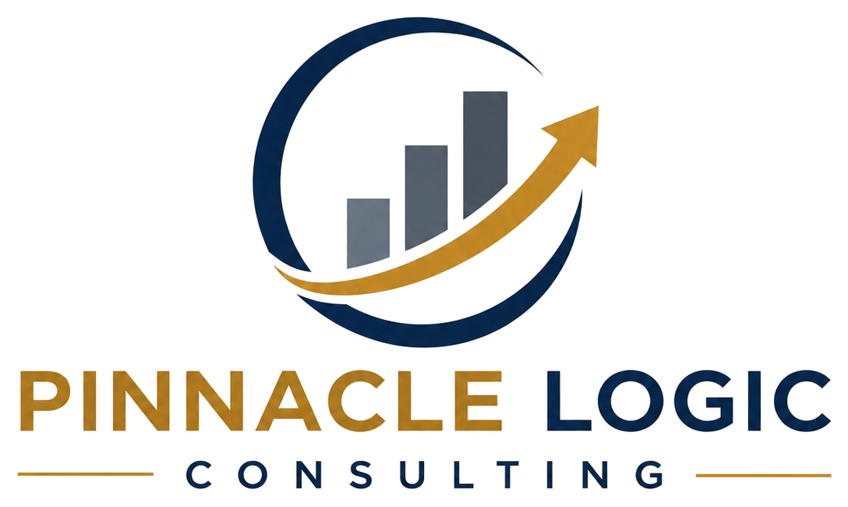
THE PROFIT PROBLEM
Most factories are quietly leaving profit on the table
The losses rarely show up in the P&L as a single line — they hide inside low utilisation, excess effort, and slow flow. They are recoverable, and usually without buying new machines.
40–60%
15–35%
20–40%
Typical effective OEE on lines that look 'fully loaded'
Manpower effort recoverable through balancing & standard work
Lead-time compression possible by fixing flow, not adding capacity
The question is not whether the losses exist — it is how much profit they are costing you right now.
2

Slide 3





WHERE THE MONEY GOES
The eight hidden losses that erode profitability
Low OEE
Excess Manpower
Long Lead Times
Poor Material Flow
Availability, performance & quality losses
Imbalanced lines & non–value-added effort
Slow flow and poor customer response
Excess movement and handling waste
Capacity Constraints
Excess Inventory
Breakdown Losses
Changeover Losses
Bottlenecks throttling throughput
Working capital locked on the floor
Unplanned downtime and reactive maintenance
Long setups stealing productive hours
TPL Consulting identifies and removes these losses — converting them into recovered capacity, lower cost and higher EBITDA.
3

Slide 4

THE CEO VIEW
From profit leakage to profit recovery
WHAT DRAINS PROFIT
WHAT TPL RESTORES
Revenue
TPL Intervention
Production Losses
Profit Recovery
Breakdowns
Higher Capacity
Excess Manpower
Higher Productivity
Inventory
Lower Cost
Waiting & Rework
Hidden Profit Leakage
Higher EBITDA
4

Slide 5

PROOF OF IMPACT
Business value created & identified
VALUE BY ENGAGEMENT
₹43.42 Cr+
Total value created and identified across engagements
Recovered with minimal capital investment
5

Slide 6





OUR APPROACH
How we convert operational losses into profit
01
02
03
04
Diagnose
Quantify
Execute
Sustain
Shopfloor study, DILO, OEE & bottleneck analysis to locate the real losses.
Translate every loss into rupees — capacity, manpower, lead time, working capital.
Hands-on implementation with your teams: SMED, line balancing, flow & standards.
Standard work, visual management and KPIs that lock the gains in place.
No theory for its own sake — every action is tied to a measurable financial outcome.
6

Slide 7

CASE STUDY 1
Leading Automobile & Electronics Manufacturer
BUSINESS VALUE
₹1.2 Cr
LAYOUT & MATERIAL FLOW — BEFORE vs AFTER
THE CHALLENGE
BEFORE — tangled flow
AFTER — lean flow
Poor material flow and layout inefficiencies caused excess movement.
WHAT WE DID
Spaghetti diagram
Material flow analysis
Lean layout design
35%
7,000 sq.ft
₹1.2 Cr
Reduction in movement
Floor space optimised
Annual impact
11

Slide 8
CASE STUDY 2
Leading FMCG Manufacturer
BUSINESS VALUE
₹2.0 Cr
VALUE STREAM TRANSFORMATION
THE CHALLENGE
Order
Plan
Produce
Pack
Dispatch
Long lead times and slow customer response were tying up working capital.
Bottleneck removed at the production step to unblock end-to-end flow.
WHAT WE DID
ORDER-TO-DISPATCH LEAD TIME
Value Stream Mapping (VSM)
Inventory analysis
Bottleneck identification
Scheduling optimisation
Before
3 days
After
2.1 days
30% reduction in lead time — faster response, lower inventory
8

Slide 9
CASE STUDY 3
Leading FIBC & Bulk Bag Manufacturer
BUSINESS VALUE
₹3.5 Cr
OEE IMPROVEMENT
THE CHALLENGE
Low OEE and long changeover times were capping output on critical lines.
WHAT WE DID
OEE loss analysis
Total Productive Maintenance (TPM)
SMED for rapid changeovers
Standardised changeover procedures
CHANGEOVER TIME
OEE UPLIFT
12 hrs → 7.4 hrs
+23 %
7

Slide 10
CASE STUDY 4
Leading Integrated Steel Manufacturer
BUSINESS VALUE
₹18.0 Cr
PLATE MILL PROCESS & BOTTLENECK
THE CHALLENGE
Reheat
Roll
Level
Cut
Finish
Capacity constraints in the Plate Mill were limiting throughput and sales.
BOTTLENECK
WHAT WE DID
CAPACITY OPPORTUNITY
Process mapping
DILO study
Bottleneck analysis
Capacity study
₹18 Cr
32%
uplift
identified
of additional throughput value identified — without new capital equipment.
10

Slide 11
CASE STUDY 5
Leading Wire & Cable Manufacturer
BUSINESS VALUE
₹18.72 Cr
WORKFORCE OPTIMISATION
THE CHALLENGE
High manpower and low productivity were inflating cost per unit.
WHAT WE DID
Day-In-the-Life-Of (DILO) study
Time study
Line balancing
Work standardisation
821
35%
₹18.72 Cr
Operators optimised
Workforce reduction
Annual saving
9

Slide 12
THE FULL PICTURE
Portfolio of value at a glance
ENGAGEMENT | SECTOR | KEY RESULT | VALUE
OEE Improvement & SMED | FIBC & Bulk Bag | OEE 37% → 60%; changeover 12 → 7.4 hrs | ₹3.5 Cr
Lead Time Reduction | FMCG | 30% faster order-to-dispatch | ₹2.0 Cr
Workforce Optimization | Wire & Cable | 2,345 → 1,524 operators (35%) | ₹18.72 Cr
Plate Mill Capacity | Integrated Steel | 32% throughput opportunity identified | ₹18.0 Cr
Layout Optimization | Auto & Electronics | 35% less movement; 7,000 sq.ft freed | ₹1.2 Cr
TOTAL VALUE CREATED & IDENTIFIED
₹43.42 Cr+
12

Slide 13




THE DIFFERENTIATORS
Why manufacturers choose PL Consulting
₹43+ Cr value created & identified
Hands-on shopfloor execution
Data-driven problem solving
Outcomes measured in rupees, not slideware
We implement on the floor, not just advise
Decisions grounded in study and measurement
Lean Six Sigma methodology
Manufacturing domain expertise
Sustainable results
Proven, structured improvement discipline
Deep operational know-how across sectors
Gains locked in with standards & KPIs
13

Slide 14





WORKING TOGETHER
A low-risk path to recovering profit
01
02
03
04
05
Diagnose
Analyze
Design
Implement
Sustain
Shopfloor study, data capture, DILO & loss mapping
Root-cause, bottleneck & capacity analysis
Solution design, roadmap & business case
Pilot, SMED/line-balancing & quick wins
Standards, KPI dashboards & capability build
14

Slide 15




PL CONSULTING
Let's improve your
factory's profitability
Unlock hidden capacity, productivity and profit.
+91 84396 92259
tarunsharma301996@gmail.com
LinkedIn — inkedin.com/in/tarun-sharma-52ba6a15b
Tarun Operational Excellence Consultant

